Slide 1
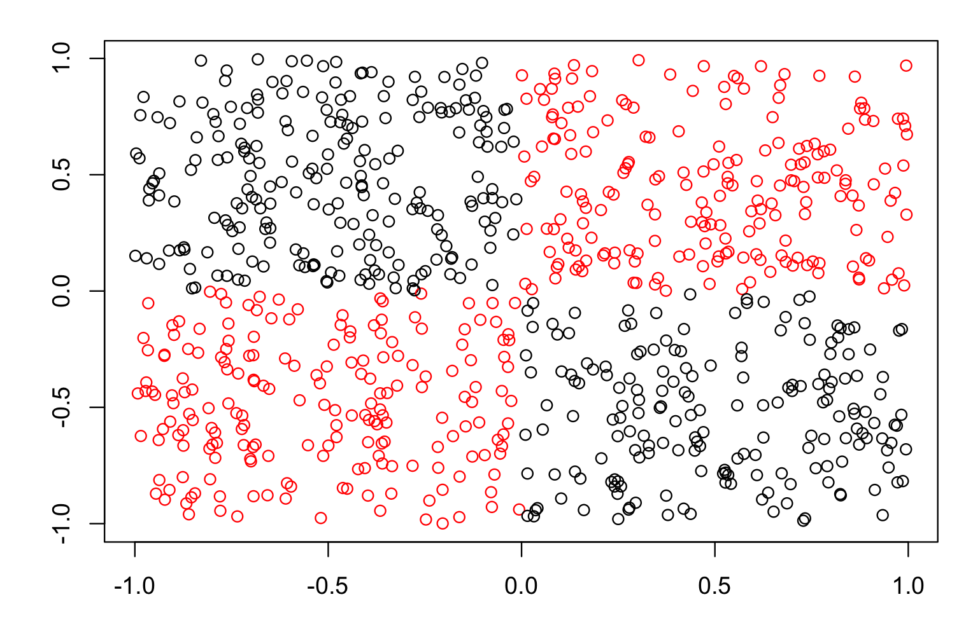
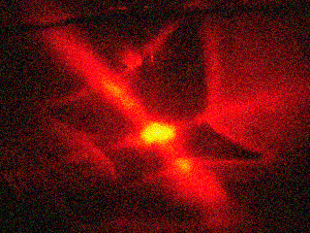
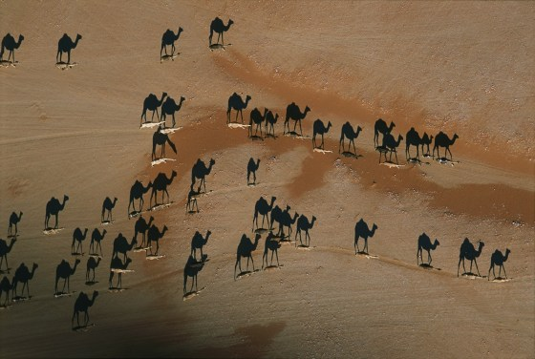
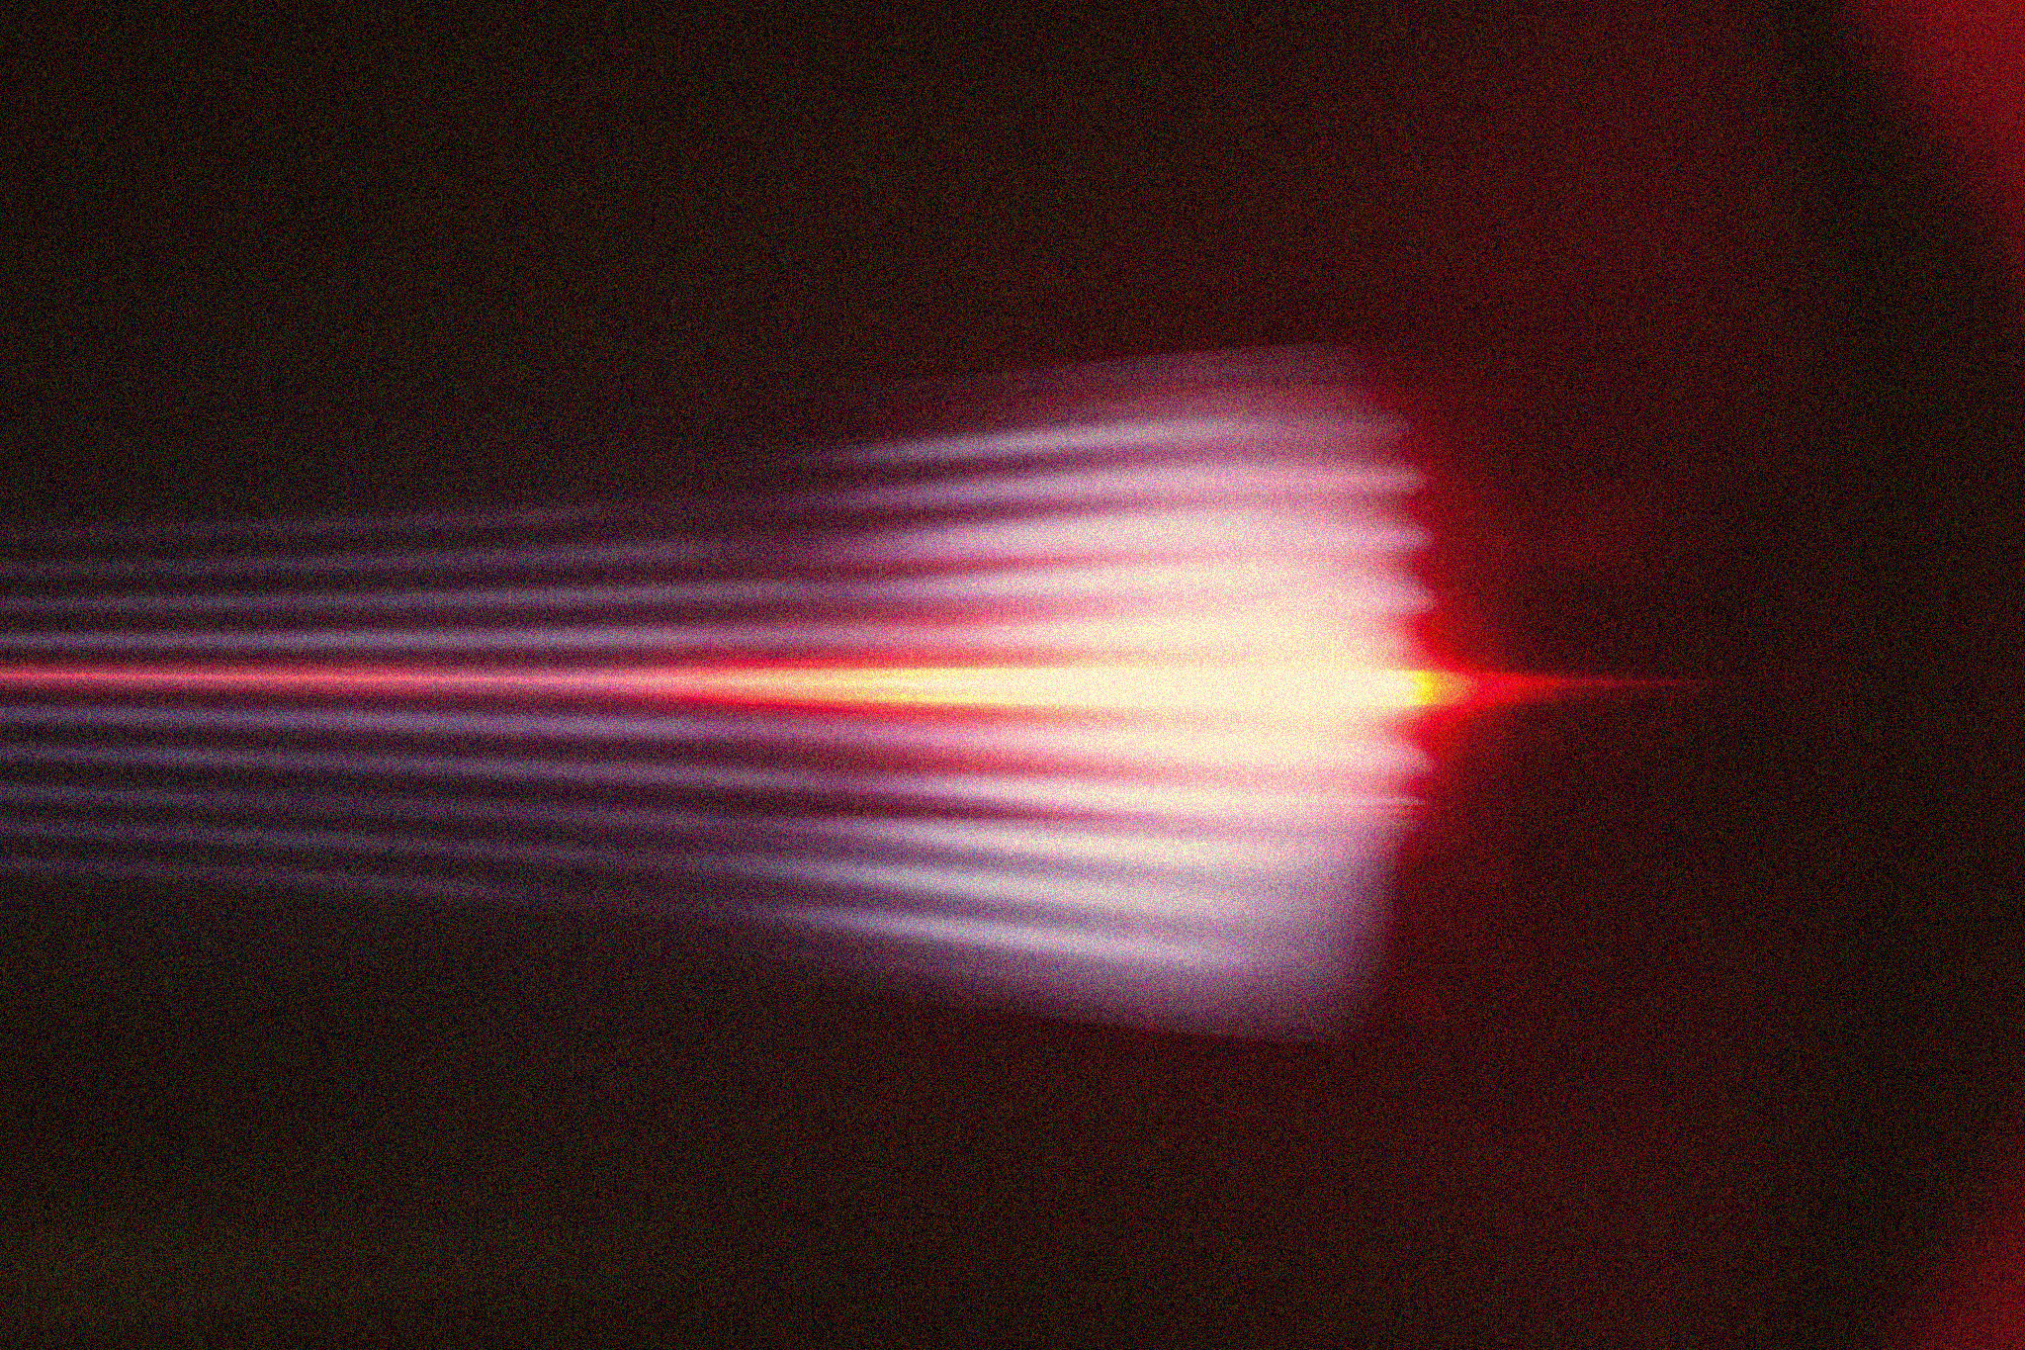

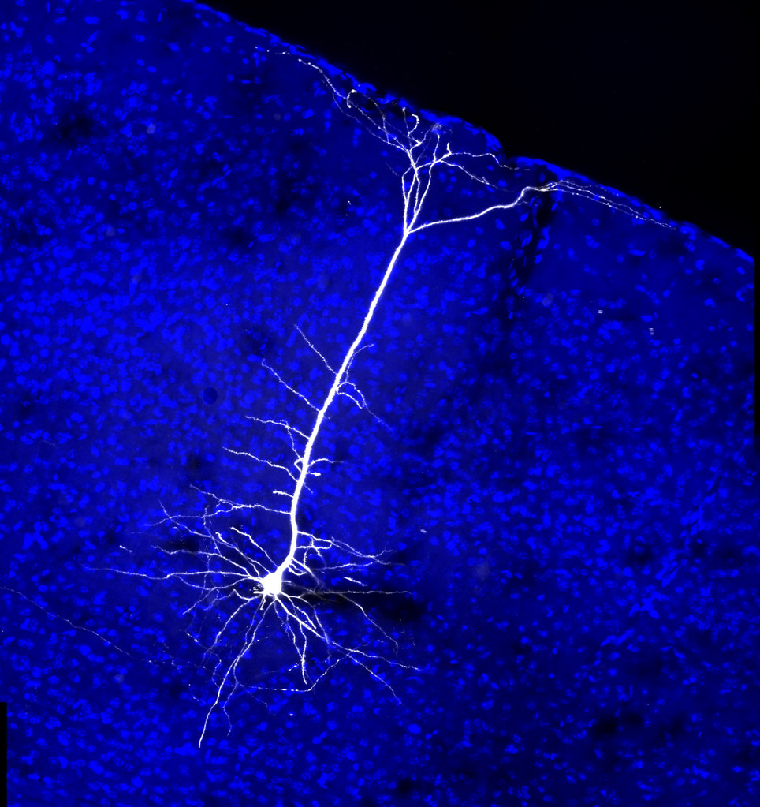
APP PHYSICS 157
COMPUTATIONAL ANALYSIS AND MODELLING
BINARY CLASSIFICATION
MACHINE LEARNING – MODULE 2
NINO PHILIP RAMONES | GITHUB
2020 – 05616
JULY 3, 2023
This Photo by Unknown Author is licensed under CC BY-NC-ND

Slide 2

APP PHYSICS 157
BINARY CLASSIFICATION
OBJECTIVES
Explore the different binary classifiers such as perceptron and logistic regression on classifying or differentiating two datasets together
Perform the basics of perceptron learning and logistic regression algorithms
KEY TAKEAWAYS
Binary classifiers can be applied to any linearly separable data
Higher learning rate results to faster weight change at the risk of overshooting and not finding a good solution as the algorithm converges to a local minimum in the shortest time possible
Lower learning rate means less risk of overshooting, but more iterations are needed to find a good value for convergence
Different activation functions can be used to train the model
SOME PITFALLS
Large number of datasets can yield to a longer runtime and training of the model as the algorithm is somewhat numerically sensitive to the learning rate value

Slide 3
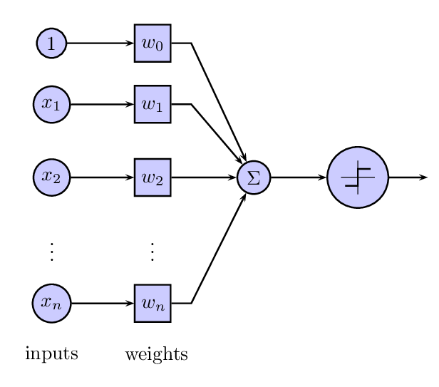
APP PHYSICS 157
BINARY CLASSIFICATION
BINARY CLASSIFIERS
On the interesting models of supervised learning of binary classifiers
Perceptron learning. The perceptron classification algorithm assumes that the data points are linearly separable wherein a hyperplane separates clusters of data. In principle, it is activated by a step function, i.e. it only returns 0 and 1 which will dictate to which class the object belongs to. The weights are chosen randomly at first and continually refined by iterating through the samples for a number of epochs.
Figure 1. This Photo by Unknown Author is licensed under CC BY-SA.
Logistic regression. The logistic regression runs in the same principle as the perceptron except that instead of returning two discrete value of 0 and 1, the output ranges between 0 and 1 by modifying the activation function to be a sigmoid. The output is interpreted as the probability that a certain data point belongs to a class.

Slide 4
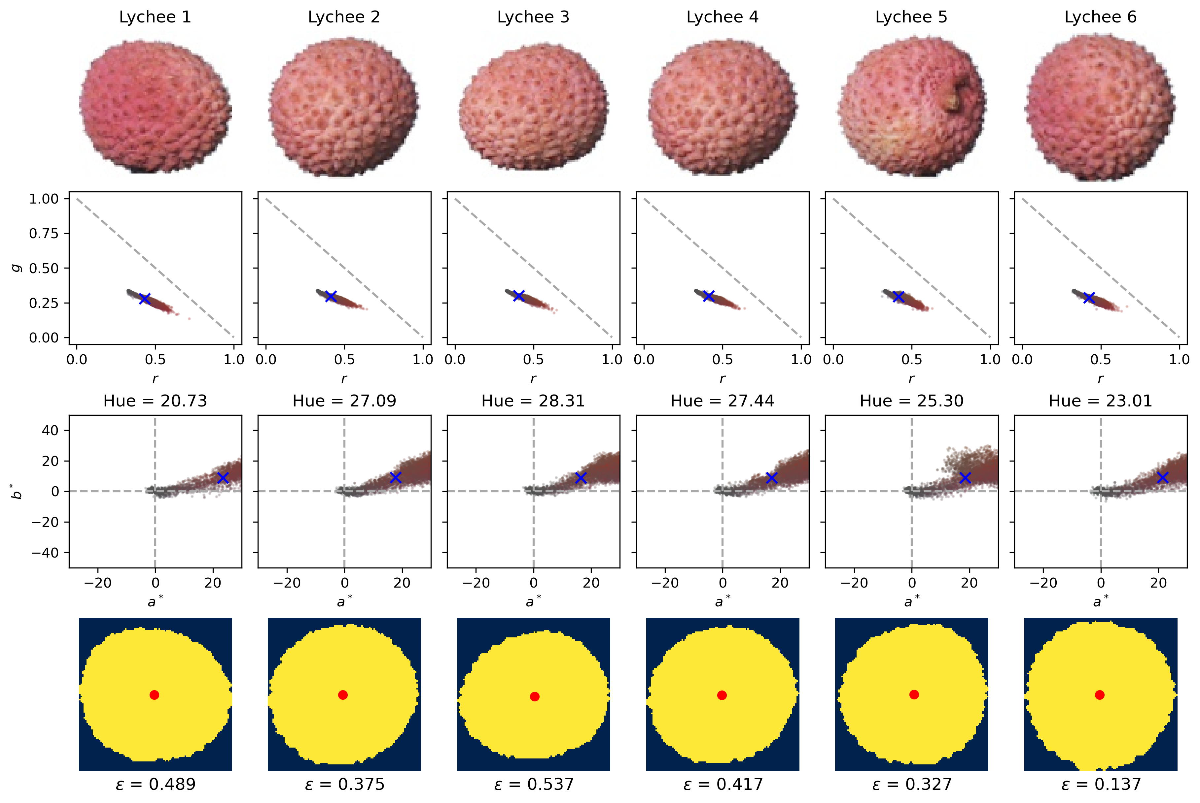
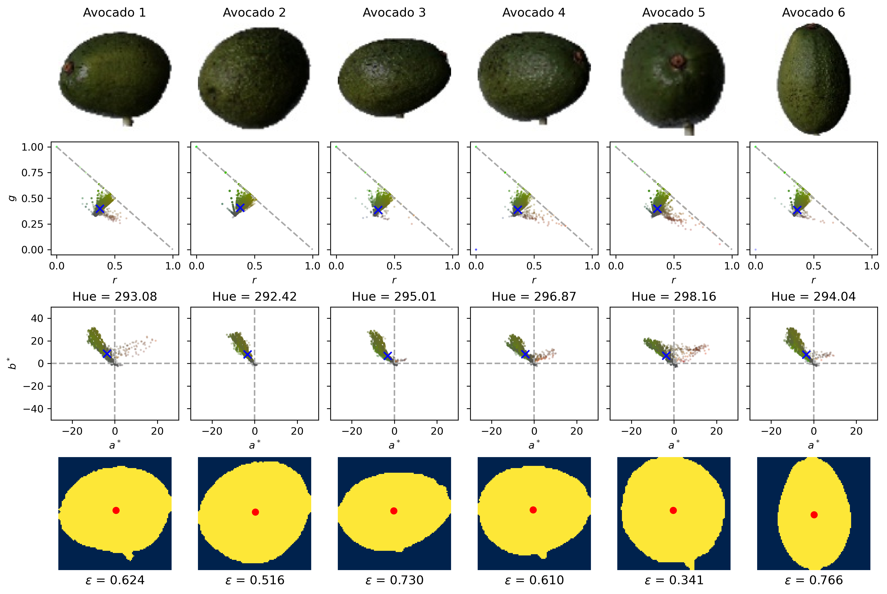

APP PHYSICS 157
BINARY CLASSIFICATION
FRUITS DATASET
Figure 2. Feature extraction of some fruit images from Kaggle. The mean Lab from CIELab color space were deduced from the mean RGB of the fruits. Eccentricity data was obtained using regionprops.
We revisit some of the previous algorithms used for feature extraction in the previous activities. By converting the RGB color space to CIELab color space, the hue of the fruits were obtained using
where a and b denote the chroma of the fruit from green to red along the a-axis, and blue to yellow for the b-axis. The eccentricities were calculated upon thresholding and labelling using regionprops.

Slide 5
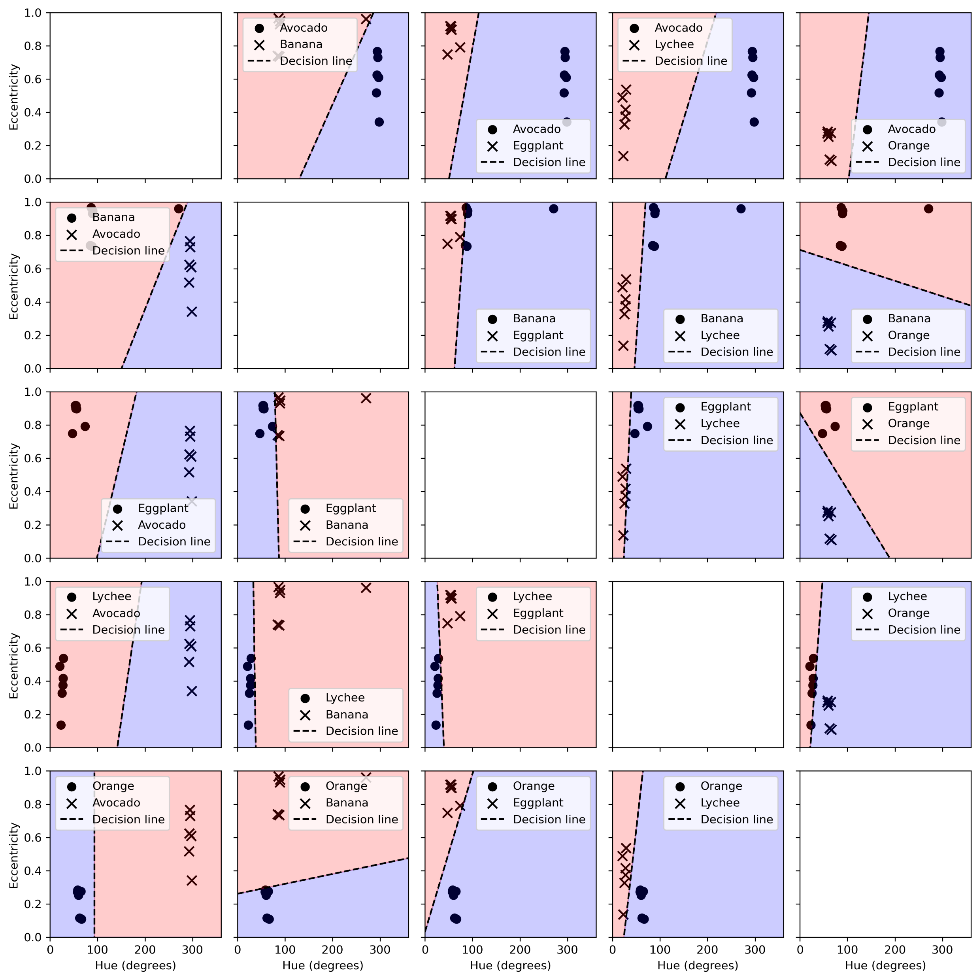
A sort of adjacency matrix that demonstrates the classification between two fruits were done through the perceptron learning algorithm. In this activity, five different fruits were tested, and their eccentricities and hues were used as the classifying parameter to distinguish two fruits together. Since the data are mostly linearly separable, the perceptron was trained with optimal convergence for around 1000 epochs and a learning rate of 0.01.
Figure 3. The decision lines generated by the perceptron algorithm that distinguishes two fruits together.

Slide 6
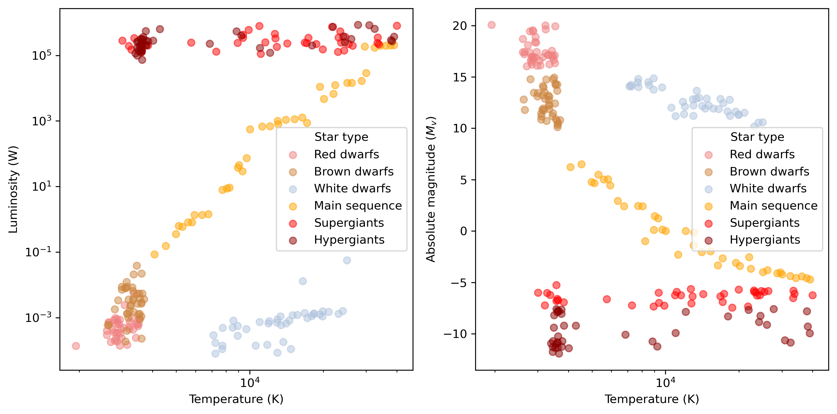
APP PHYSICS 157
BINARY CLASSIFICATION
STAR CLASSIFICATIONS
Figure 4. Star dataset to predict star types from Kaggle. The average luminosity and absolute temperature of different stars were plotted to resemble the Hertzsprung-Russell diagram that shows the relationship between the two mentioned quantities.
From the outsourced data of different stars in Kaggle, the absolute temperature and luminosity of stars were observed. The Hertzsprung-Russell diagram shows the distribution of such stars across the celestial space based on their temperatures and luminosities. We can then train the perceptron to classify the data and see how the decision lines compare for a data that are not linearly separable in some cases!

Slide 7
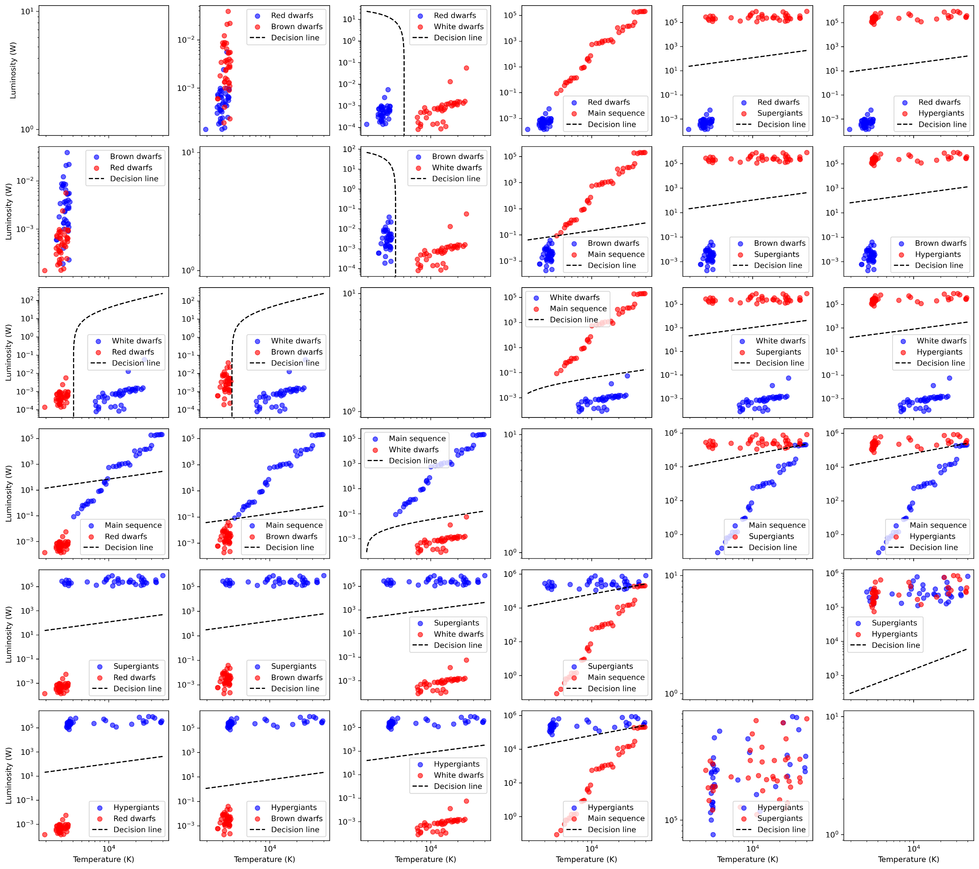
Training the perceptron to classify the stars generated a decision line to most of the star pairs. Although, convergence were not guaranteed on some cases where the data are not linearly separable such that of the brown dwarf vs red dwarf comparison. Since the dataset is generally huge, higher iteration counts were needed and a slight adjustment to the learning rate – slightly higher lower than 0.01 – were made.
Figure 5. The decision lines generated by the perceptron algorithm that distinguishes two star types together.

Slide 8
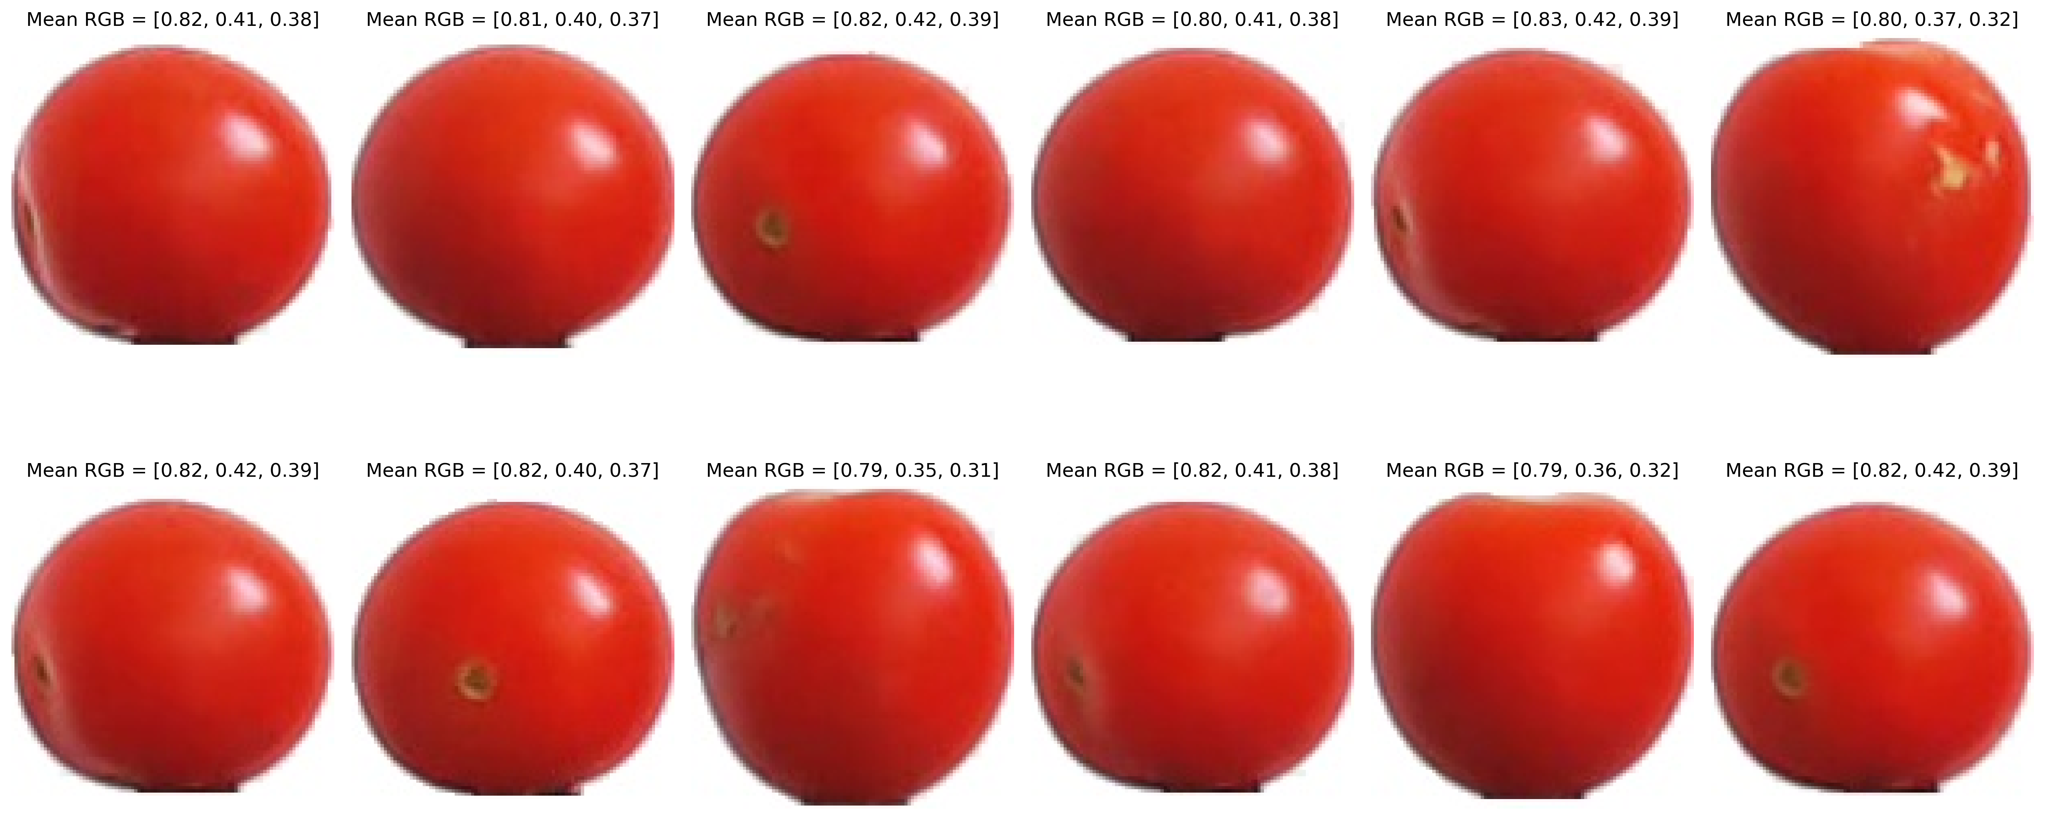
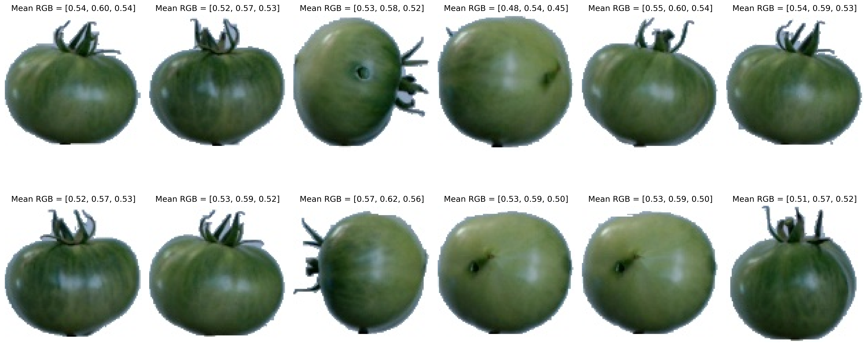
APP PHYSICS 157
BINARY CLASSIFICATION
RIPENESS PREDICTION
By modifying the activation function from the perceptron learning to a sigmoid, we can then obtain a probabilistic output that determines the likelihood of an object or feature to belong in a class. One of the most interesting characteristic of logistic regression is the ability to train a model to determining the ripeness of a fruit based on its color. The model was trained by feeding the mean RGB of ripe and unripe tomatoes and iterating throughout the training samples until convergence is achieved and the desired weight is drawn!
Figure 6. Images of ripe and unripe tomatoes from Kaggle. The sample images were used as training data in determining the ripeness of a fruit of varying shades between green (unripe) and red (ripe).

Slide 9
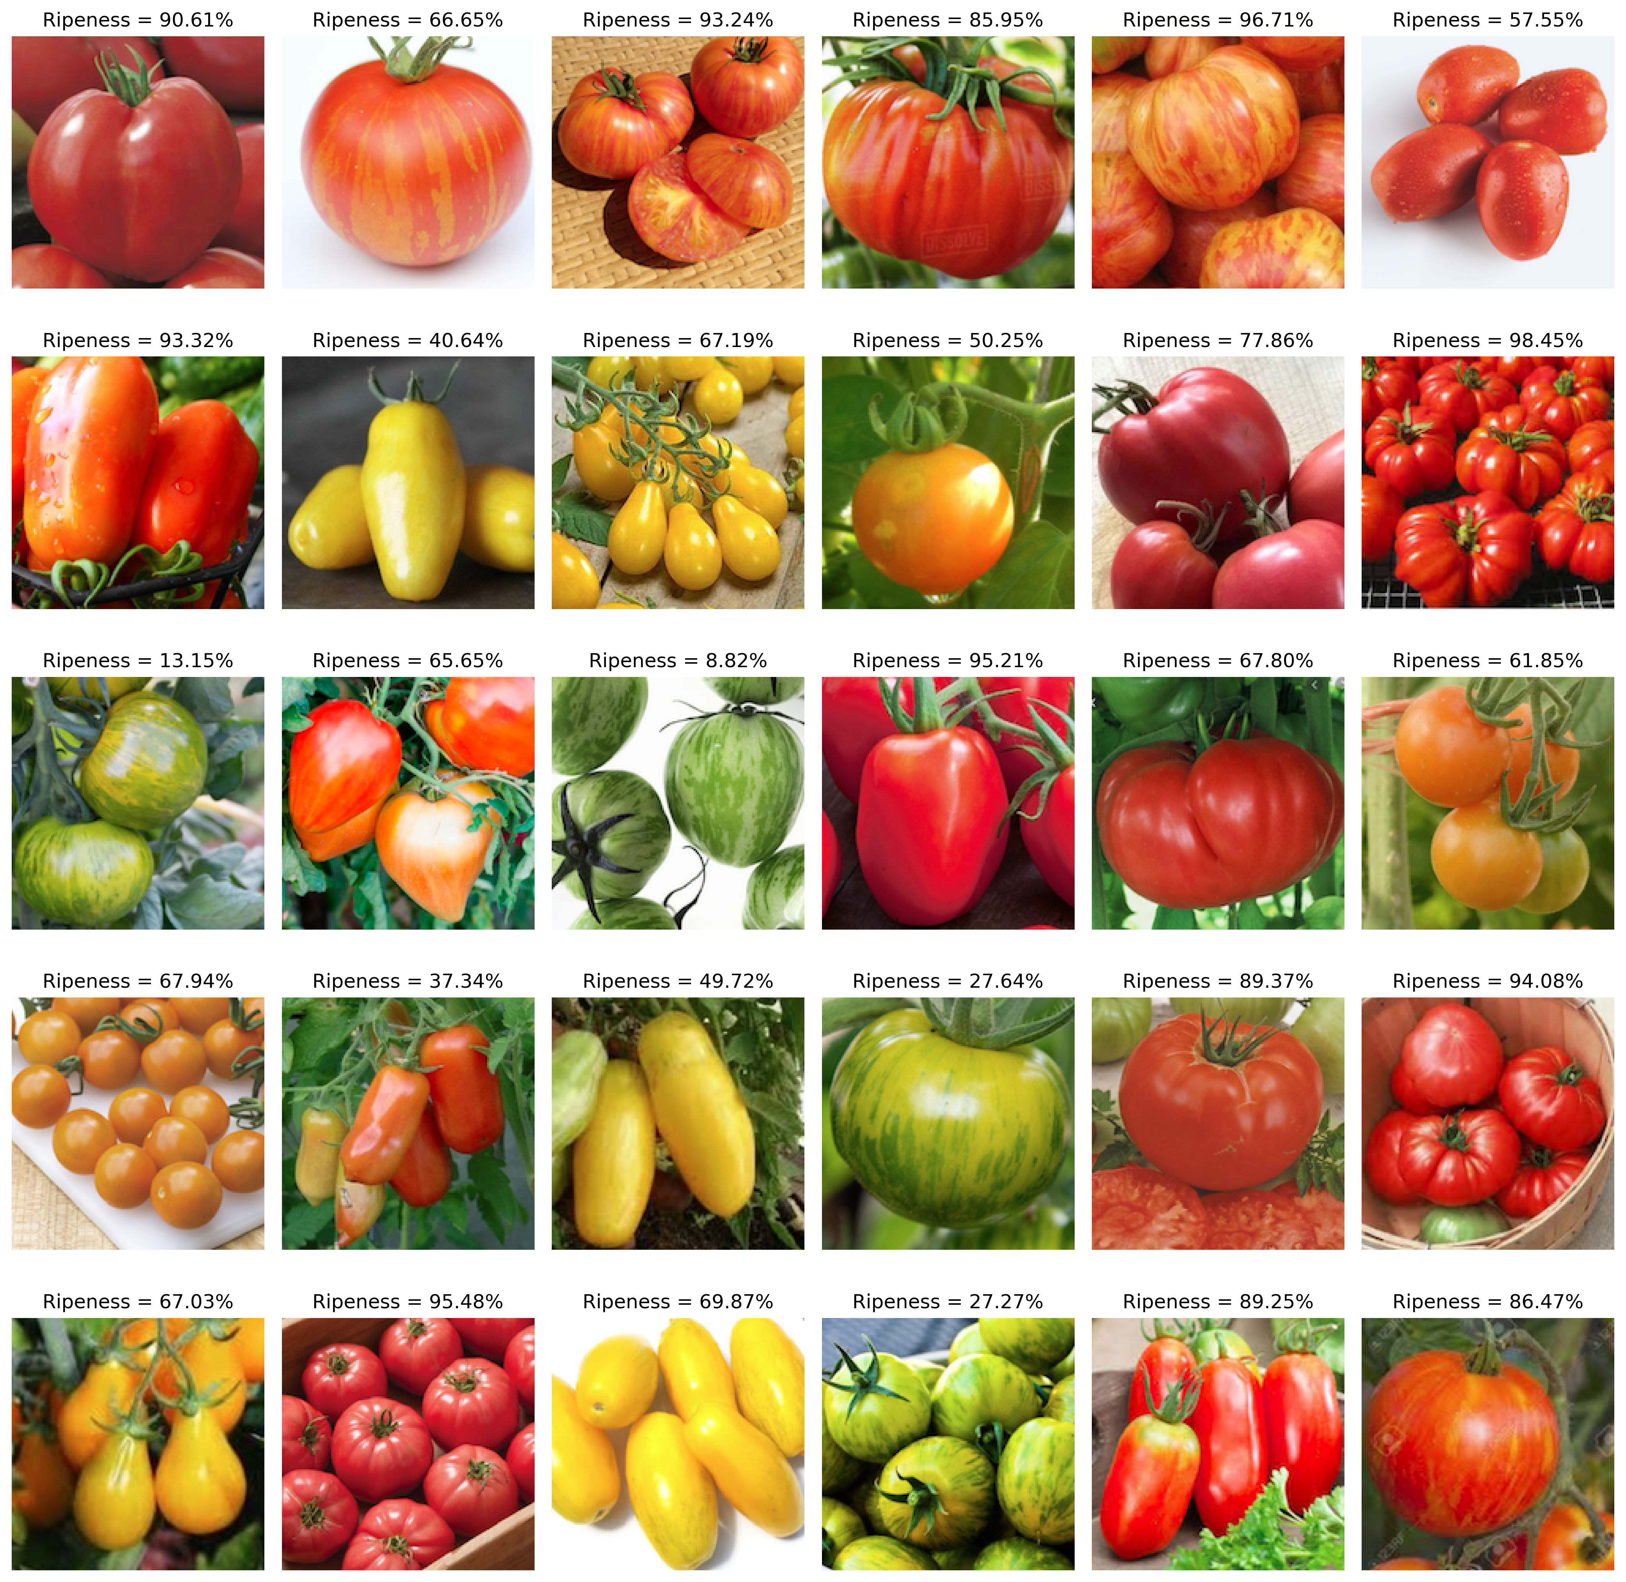
RIPENESS
Using different images of tomatoes of varying colors or degree of ripeness, the output (ripeness percent) was obtained by feeding the final weight from the training data and the mean RGB of every image of the fruit to an algorithm, i.e. the dot product of the padded feature vector and weight vector is the probability that the fruit is riped or it belongs to the riped class!
Figure 7. Images of different tomatoes of varying color shades to determining the degree of ripeness. The model was trained at around 2000 epochs at a learning rate of 0.01.

Slide 10
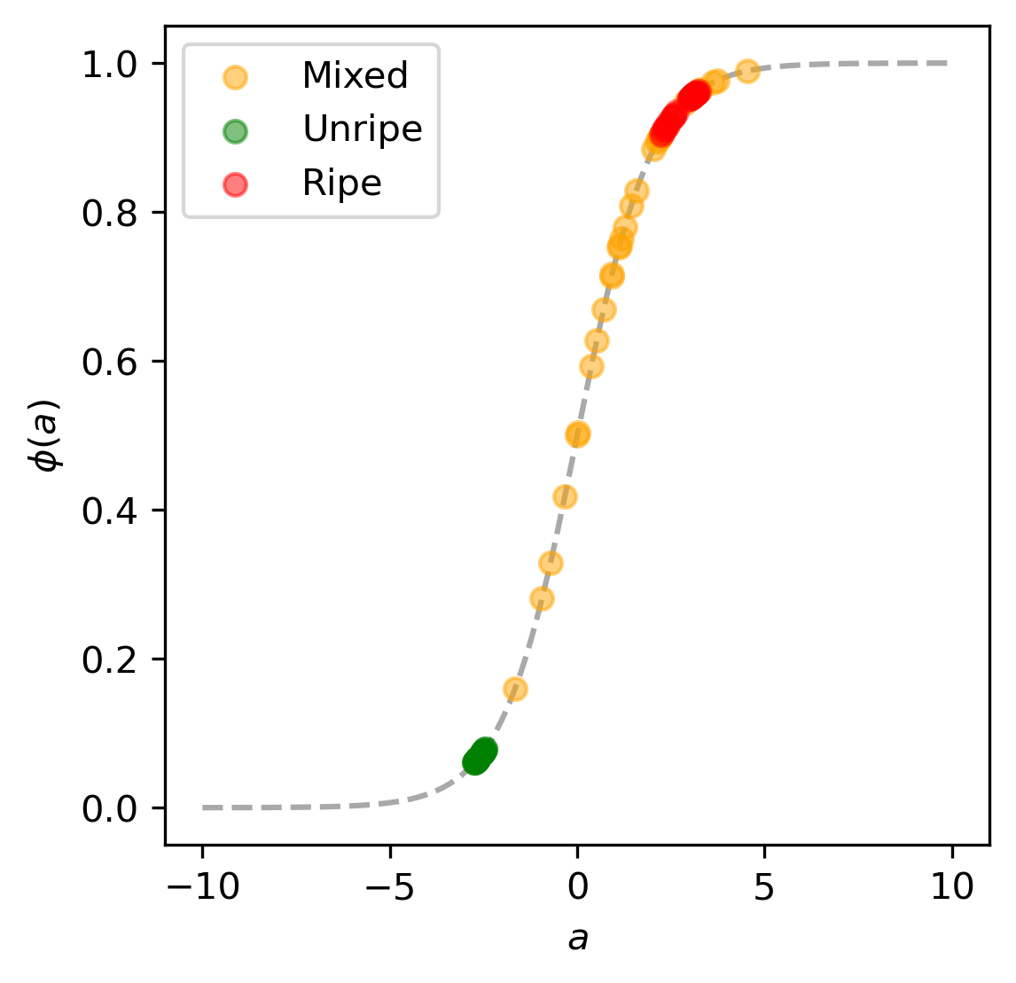
APP PHYSICS 157
BINARY CLASSIFICATION
SIGMOID OUTPUTS
Plotting the activation function and the corresponding outputs after the weight change from the trained model, it can be inferred that the mixed images of tomatoes falls in between the unripe and ripe thresholds. Some outliers beyond the ripe training data were observed, which can be attributed to the presence of other colors in the image as the training images were isolated compared to the actual prediction data samples.
Figure 8. The input a and sigmoid output $φ\left(a\right)$ plotted against each other for the training and prediction dataset.

Slide 11
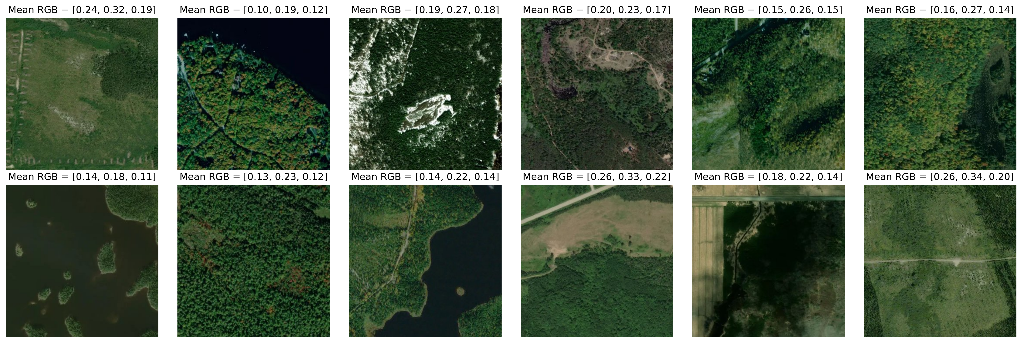
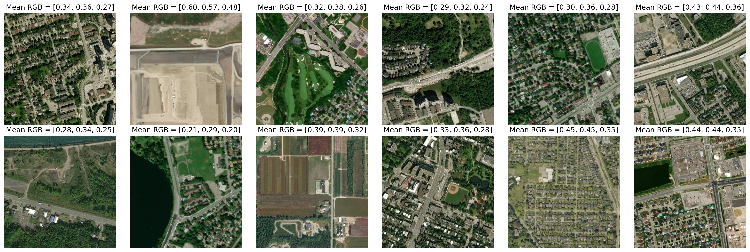
APP PHYSICS 157
BINARY CLASSIFICATION
WILDFIRE PREDICTION
Interestingly, we also examined some satellite images of urban and rural area captures from Kaggle around some areas in Canada that have or may have not experienced a wildfire before. Extracting the mean RGB of the
individual images, the model was trained to determine whether an area is at risk to a wildfire based on a likelihood basis. Since rural areas tend to be more dominated by lush greens compared to the pavement-dominated urban areas, the mean RGB can be a reasonable feature to consider although the accuracy of the training data can be quite subpar as the presence of greenery is also seen in urban areas as shown.
Figure 9. Satellite images of urban and rural areas from Kaggle. The sample images were used as training data in determining the likelihood of an area to experience wildfire using the mean RGB value of the scenes.

Slide 12
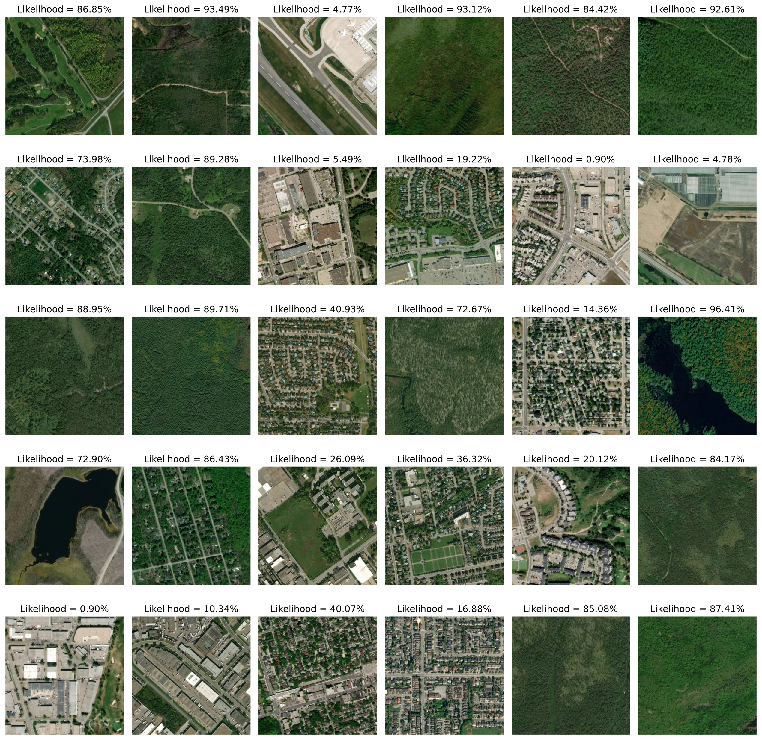
Images were randomly chosen from a prediction dataset, and the resulting likelihood values were reasonable enough to check whether an area or scene is at risk to a wildfire. The regression algorithm was still able to yield a sound likelihood although neural networks are much more designed in feeding images like these and decide which areas are at risk. Perhaps, using the mean RGB of the images could work to train the model, but not the most ideal sort of!
Figure 10. Likelihood of different satellite captures to catch a wildfire using logistic regression. Model was trained at ~2000 epochs at a learning rate of 0.01.

Slide 13
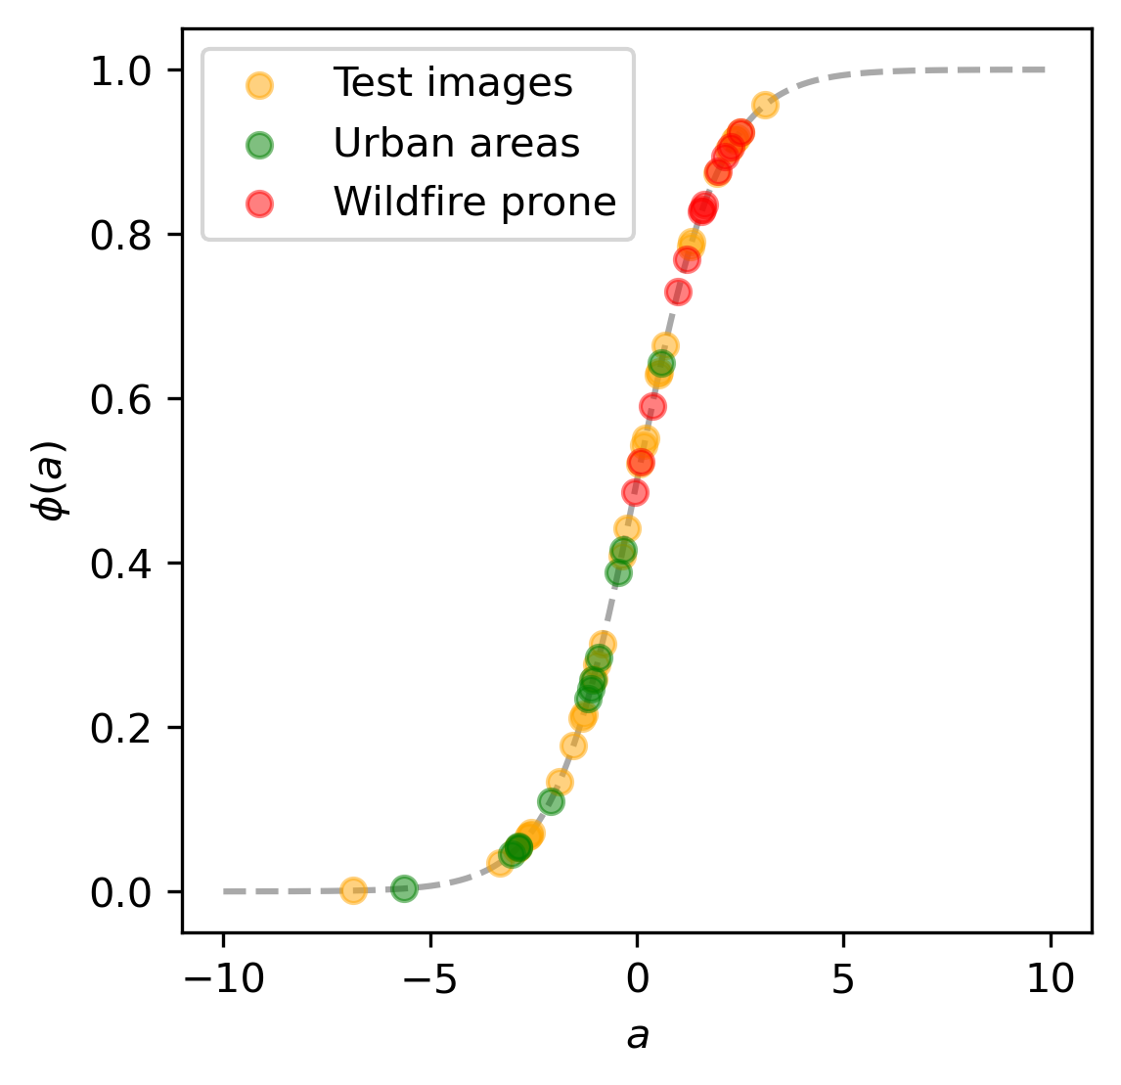
APP PHYSICS 157
BINARY CLASSIFICATION
SIGMOID OUTPUTS
Examining the sigmoid function and prediction data outputs, the test image points were quite scattered across the urban and wildfire prone area thresholds, which is indicative that the mean RGB of the training data were not the most ideal data to use. The results were reasonable, but these can be further improved by increasing the number of training data images or increasing the number of iterations at the expense of a much lower learning rate.
Figure 11. The input a and sigmoid output $φ\left(a\right)$ plotted against each other for the training and prediction dataset.

Slide 14
APP PHYSICS 157
BINARY CLASSIFICATION
REFLECTION
I was able to enjoy the activity as it served as an introductory course and test our understanding on machine learning in general. The application of the binary classification algorithms to the real-world datasets were fulfilling as the concept of training a model through perceptron learning and regression made more sense. Overall, I would give myself a score of 110/100 !
REFERENCES | GITHUB
M. Soriano, Applied Physics 157 – Machine Learning, 2023.
The CIELAB L*a*b* System – the Method to Quantify Colors of Coatings - Prospector Knowledge Center (ulprospector.com)
Fruits 360 | Kaggle
Star dataset to predict star types | Kaggle
Wildfire Prediction Dataset (Satellite Images) | Kaggle

